Slide 1
Auto-ISAC ACT Advanced Wireless Lab – 2026 Syllabus
Intro
  US Laws & Regulations
  Radio Modulation
  FCC ID Lookup
  MAC ID Lookup
Bluetooth
  Scanning
  Enumerating
  Identifying
  Analyzing
  Pairing
  Data
WiFi
  Analyzer
  WiFite
  HackISAC
GPS
  Viewing
Cellular
  Overview
SDR
  FM Radio
  Keyfob record
  Keyfob replay
  Keyfob decode

Slide 2
US Laws, Guidelines & Rules
FCC
  General Radio
    https://www.fcc.gov/media/radio/low-power-radio-general-information
  Spectrum Allocation
    Many of the devices mentioned use unlicensed bands
    https://www.fcc.gov/engineering-technology/policy-and-rules-division/general/radio-spectrum-allocation
  Unauthorized Radio Operation
    There are restrictions on band usage and power levels
    Violation of these rules are against the law
    https://www.fcc.gov/consumers/guides/unauthorized-radio-operation
  Jammer Enforcement
    Jammers are against the law
    https://www.fcc.gov/general/jammer-enforcement
  Device Lookup
    Transmitting Devices in the US must be FCC certified and labeled
    https://www.fcc.gov/oet/ea/fccid
    https://fccid.io/
    Useful for obtaining additional information on wireless devices

Slide 3
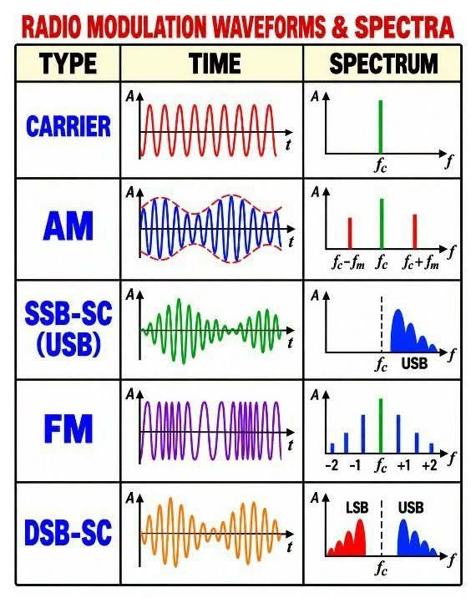
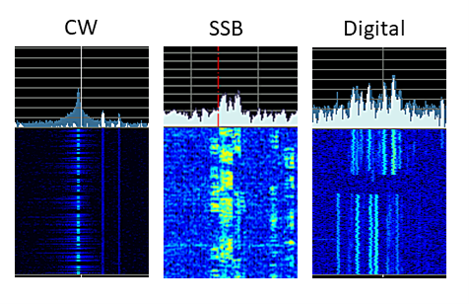

Slide 4
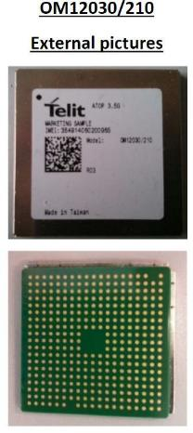
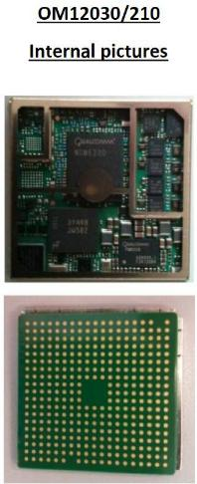
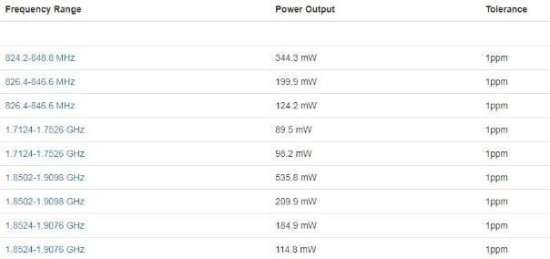
FCCID Lookup – Research
Operating Frequencies

Slide 5
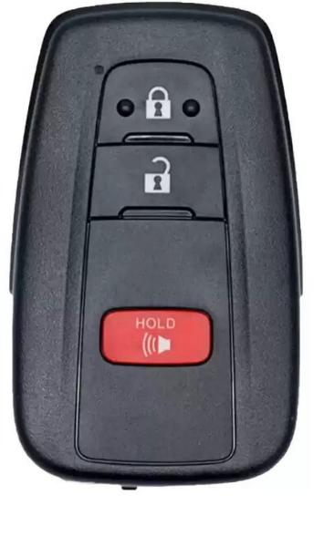
FCCID Lookup – Exercise
Take a key fob / Use your own key fob
Find the FCCID on the key fob
Search on Google
https://www.fcc.gov/oet/ea/fccid
FCCID [ID ON KEY FOB]
4. What frequency does the key fob run on?

Slide 6
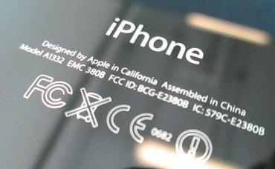
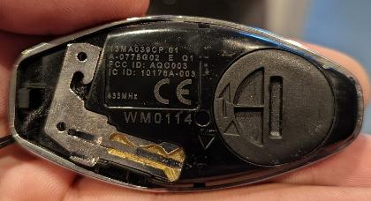
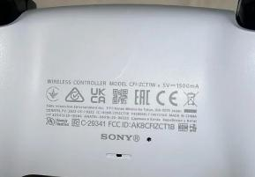
FCCID Lookup – Other Examples
iPhone FCCID
Key Fob FCCID
PS5 Controller FCCID
38

Slide 7
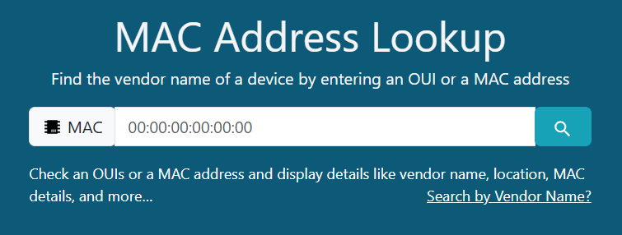
MAC ID Lookup
https://en.wikipedia.org/wiki/MAC_address
Looking up the Medium Access Control (MAC) address
Important identification of device on local networks, wired or wireless
Works with Ethernet, WiFi and Bluetooth devices
Gives Manufacturer Organizationally Unique Identifier (OUI)
https://maclookup.app/

Slide 8
Appendix
Neal’s Github repository for the lab: https://github.com/nprobert/AutoISAC-ACT-AdvWireless
If you want serious Wireless Training take the SANS 617 Wireless Penetration Testing and Ethical Hacking class: https://www.sans.org/cyber-security-courses/wireless-penetration-testing-ethical-hacking as it was just recently updated.
Well known RF tools:
  Flipper Zero: https://flipper.net/ for Low Frequency (LF) work under 1Ghz
  FreeWILI: https://freewili.com/ useful for car hacking
  HackRF: https://greatscottgadgets.com/hackrf/ is a popular SDR
  RTL-SDR: https://www.rtl-sdr.com/ for SDR information and news
A great tool for using with Software Defined Radios (SDR) is GNU Radio: https://www.gnuradio.org/
  Tutorial: https://www.gnuradio.org/news/2022-02-03-new-tutorials/

